Slide 1
Bienvenidos
Exploratory Spanish Day 1

Slide 2
Find your seat and index cards. Hazlo ahora = Do it now! (aka-Bell work)
Take one index card out of the box. Write Emergency info on card in- case of Tornados Emergency phone numbers will be loaded into my cell with Phone Vite- I make one call & everybody is contacted at once.
1. Your Last name, First name
2. Full Name of the adult I’m contacting AND their relation to you. (mom/dad/grandmother…ect.)
3. Anything YOU think I should know… just in case.

Slide 3
2 questions asked every year
What do I need for class?
What are we going to do? I don’t know how to learn a foreign language.

Slide 4
You are already a language master!!!
YOU SPEAK ENGLISH!!
THIS IS A LEVEL 3 DIFFICULTY LANGUAGE
SPANISH IS A LEVEL 1!!!
WHAT WE ARE DOING THIS WEEK IS REMINDING YOU HOW YOU LEARNED IN THE FIRST PLACE AND DOING IT AGAIN IN SPANISH☺

Slide 5
¿Qué necesito para clase?
Composition book any color
Pencils +Extra lead if you use mechanical pencils
Color pencils
Glue sticks apx 6. (keep one on you at all times)
A folder
Paper
Kleenex OR hand sanitizer to keep you healthy

Slide 6
¿Cuándo necesito mi material?
Lunes, el catorce (14) de enero.
(Monday, the 14th of January)

Slide 7
What do I need to do to be successful?
Have fun and do the work!
Practice EVERY day!
Learn from your mistakes!

Slide 8
A few things to know…

Slide 9
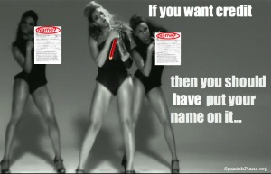

Slide 10
What you should know
You are tested on reading, writing, listening & speaking Spanish.
2. There is a website built to help them practice. katebondspanish.weebly.com
3.Writing Spanish includes spelling correctly.

Slide 11
What you should know (continued)
4. You have a semester long project broken into 4 parts.
5. There is no textbook for this class.
You build you own in your compostion book.

Slide 12
7th inning stretch
TAKE A BREAK EVERYBODY
YOU’VE BEEN TALKED AT TOO MUCH!
Stand up and stretch.
Raise a hand. Wait to be called on.
Ask your questions.

Slide 13
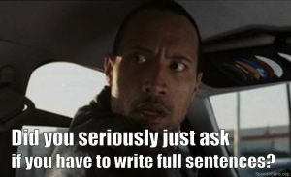
BACK OF INDEX CARD…REALLY!

Slide 14
Back of the card-Answer in full sentences.
1. On a scale of 1-10 how confident are you about your ability to learn a new language?
2. What kind of grades do you get in English?
3. What languages other than English do you Speak
4. What languages other than English can you read and write?
5. Where outside of the USA do you want to travel on vacation? What do you want to see/do?

Slide 15
I’d rather work things out in class with a laugh and an understanding….
……but I have no problem asking for help from home.
Please remember,
I’m somebody’s Mama too.

Slide 16
Yep it’s a real class…for a grade.
You are NEVER excused from this class because some other teacher wants you to help her/or to finish a project/or do make up work for another class.
I do not invent work for you the do to pretend you passed my class. There is no extra credit.
If you want to pass with ease and a High GPA you are expected to be here, to participate and to do high quality work with attention to detail.

Slide 17
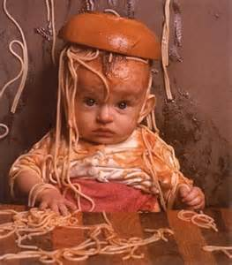
Life happens….

Slide 18
….so what to do when it does.
Resubmitting work- with in 3 days of original date. Permission first. Original stapled to it.
Illness- you have 3 days to make up work. All work posted daily on web site.
Extended absences- individually arranged.
Suspensions-All work posted on website. I will not invent work that covers interactive activities for which grades were taken. All work is on website. You are expected to spend the class time (50 minutes) practicing your speaking, reading and listening skills on the website.

Slide 19
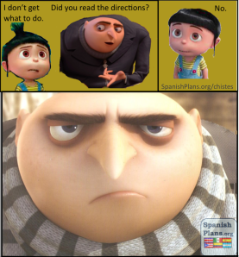
Directions and do-overs

Slide 20
Directions are one thing-tutoring is another.
Afterschool tutoring- 3:30 to 4:00 Tuesdays & Thursdays. It requires signed permission form with on time parental pickup.
(I have my own child to pick up and am not a babysitting service.)
I will not tutor is kids who goof off during class wasting class time and want my personal time for free after school.

Slide 21
¿¿¿Preguntas???

Slide 22
Syllabus Scavenger Hunt
You are too intelligent and too old for me to read the syllabus to you.
After reading the directions, work with the person beside you to find and answer the questions on they Syllabus Scavenger Hunt.
You will get 50% cut out of your grade if you do not answer writing complete sentences.
Work in pairs to find and answer the questions on the Scavenger Hunt.

Slide 23
Please!
Read your parent letter.

Slide 24
MAÑANA –¿Qué vamos hacer?
1. fire drill
2. Getting to know you?
3. The Spanish speaking world.
4. Pick one get one.

